Slide 1


Football Player
Ibrahim Alawi
Abdullah Alfadel

Slide 2
Row Dataset
17953 Rows
51 Column
Data types: float64(7), int64(35), object(9)
Shape (51, 17953)

Slide 3
Dataset After Cleaning
16181 Rows
48 Column
Data types: float64(4), int64(35), object(8),date(1)
Shape (16181,48)

Slide 4
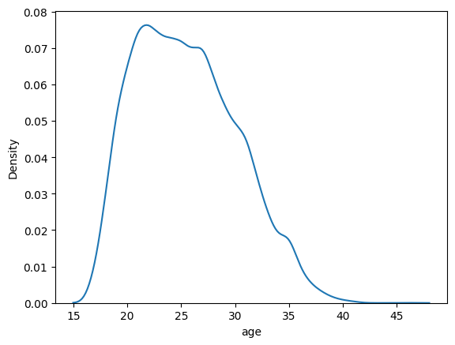

Slide 5
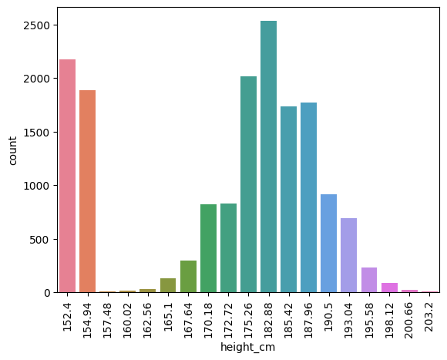

Slide 6
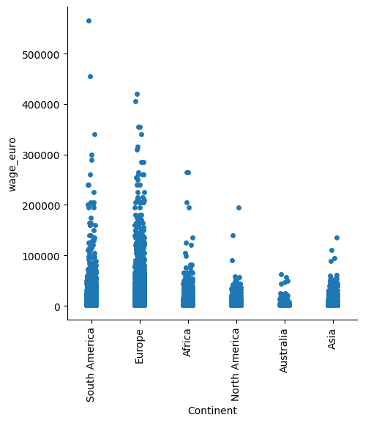

Slide 7
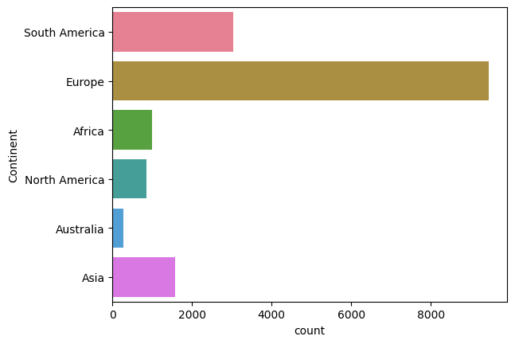

Slide 8
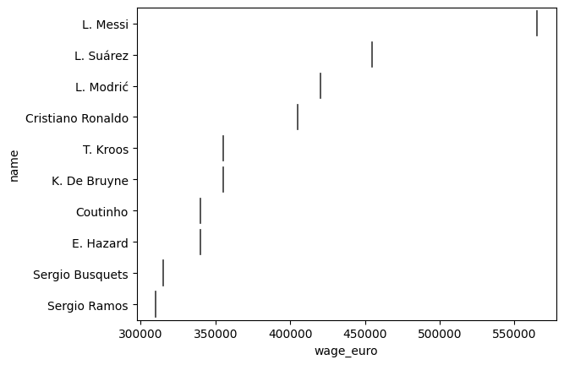

Slide 9
THANKS
Any questions?

